Slide 1
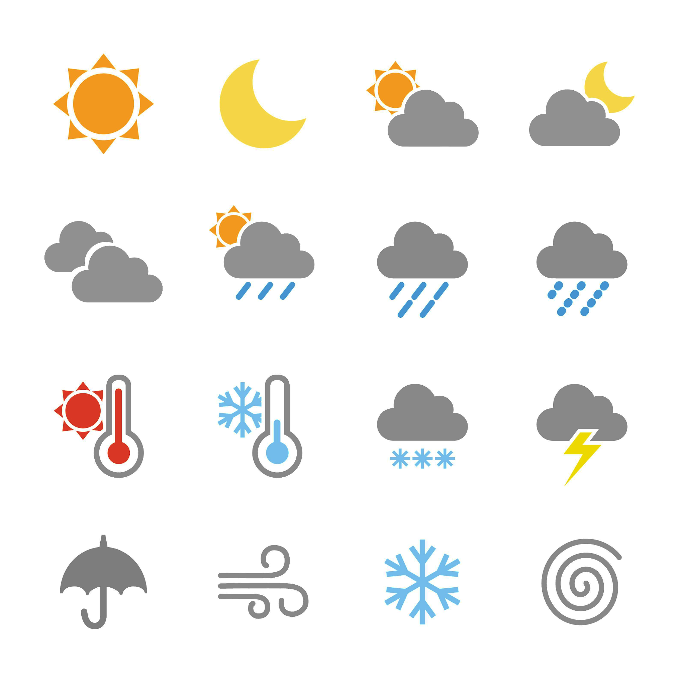
Predicting the weather
Task A: Rainfall forecasting
1) This report was published on Saturday, and shows the forecast for the next week.
 | Mon | Tue | Wed | Thu
Type of rainfall
amount of rainfall (mm) | 5 | 1.6 | 0.7 | 8.5
chance of rainfall | 75% | 40% | 15% | 90%
a) Match the following amounts of rainfall to the days they are most likely to occur.
0.7 mm
1.6 mm
5 mm
8.5 mm
b) Sofia says: “it is guaranteed to rain on Thursday because 90% is a larger number than the other percentages”. Explain why Sofia is incorrect.
c) Suggest one possible reason why Wednesday still has a chance of rain, even though it is only predicted to be cloudy.
The weather prediction for any one day may not always be correct (even if the model used to predict the weather is accurate).
Also, a 90% chance does not mean rain is guaranteed, only very likely. On 1 in every 10 days with a 90% chance of rain, it is expected that it will not rain.
It may be hard to predict whether the group of clouds that are modelled to form will be rain clouds (resulting in showers) or clouds that won’t produce rain.
This is especially true since a lot of contributing factors could change between Saturday (the time the forecast was made) and Wednesday.
Weather images: Raura7/ Shutterstock.com

Slide 2
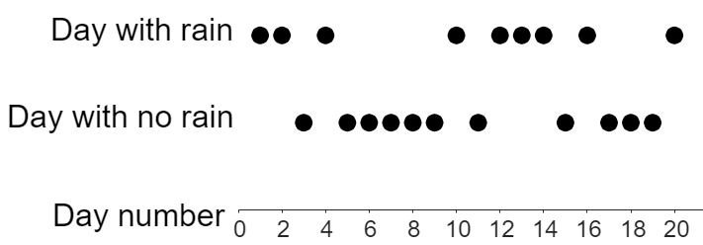
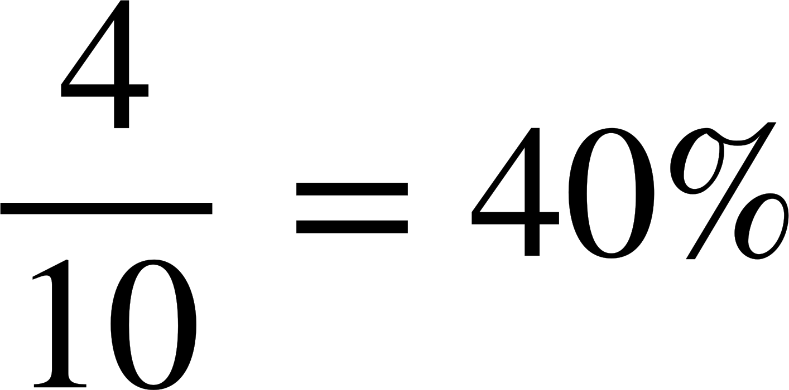
Predicting the weather
2) This report shows the amount of rainfall predicted on Saturday and Sunday.
 | Sat | Sun
Type of rainfall
amount of rainfall | 7.5 | 15°C
chance of rainfall | 100% | 73%
a) On Saturday, how many litres of water is predicted to fall for every square metre of land?
7.5 litres
A farmer has a field that is 1800 m² in area.
b) How many litres of rain will fall on this field on Saturday? You can use the ratio table given to help.
area (m²) | rainfall
1 | 7.5 litres
1800 | 13 500 litres
c) The farmer says: “3600 litres of rain will fall on my field on Sunday”.
Explain why this may not be true.
There is only a 73% chance that it will rain on Sunday. This means that there is a 27% chance that no rain will fall onto the field. Even if it does rain, the amount of rainfall is also only a prediction. It could rain more or less than 2 mm on Sunday.
3) This graph shows 20 days where the chance of rainfall was 35%. Each dot represents a day that either rained or didn’t rain.
a) How many of these 20 days would we expect to have rain?
35% of 20 = 7
b) Complete this table of information for the first 5 days on the graph.
Number of days | 5
Number of days with rain | 3
% of days with rain | 60%
c) What percentage of days for the first 10 days on the graph had rain?
d) Does this graph show: “fewer than”, “equal to”, or “greater than” 35% of days with rain?
Greater than. This is because 9 of the 20 days (45%) had rain, not the 7 (35%) that was predicted.
Weather images: Raura7/ Shutterstock.com

Slide 3
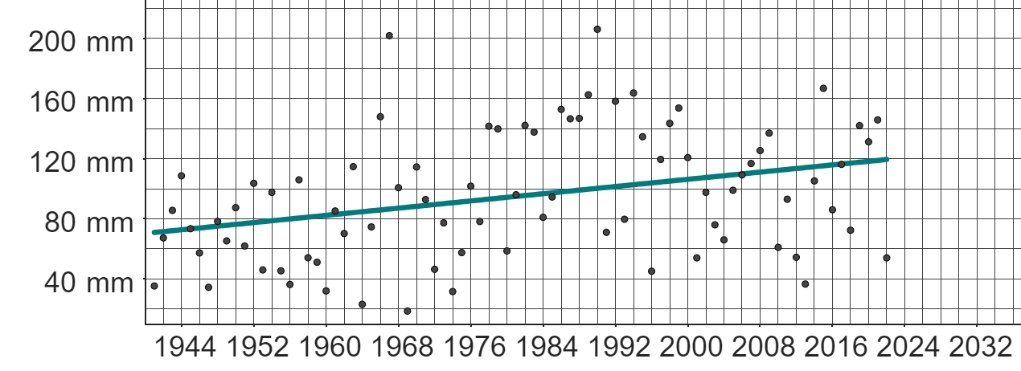
Predicting the weather
Task B: Using historical data to predict the weather
1) This graph shows data from the Met Office on the total monthly rainfall in March each year from 1941 to 2022 in Stornoway.
a) Write a sentence explaining what the trendline is suggesting about the total amount of monthly rainfall each March.
The trendline is suggesting that the amount of rainfall each March is increasing over long periods of time. This does not mean that the amount of rainfall each March will always be greater than the previous year.
b) Izzy says:
“The amount of rainfall in March 2022 is lower than in March 2021. This means the amount of rainfall in March 2023 will be even lower”.
Explain why Izzy’s assumption may not be correct.
The trendline is suggesting the opposite thing. It is important to look at longer-term trends, rather than the fluctuations between only two consecutive years.
c) Extend the trendline beyond 2022.
d) Using your extended trendline, make a prediction for the total amount of rainfall in March 2024.
e) Explain why your prediction in part d) may not be accurate.
f) Suggest a suitable range of likely predictions by considering a broader trend in the data.
A prediction of approximately 120 mm.
There is a lot of variation in March rainfall from year to year.
Future rainfall may not follow the same long-term trend as previous years.
Approximately between 75 mm and 165 mm.
g) If this was the weather forecast for March 2024 in Stornoway (based on weather conditions at the end of February 2024), explain how this might impact your prediction from part c).
week 1 | week 2 | week 3 | week 4 | week 5
12°C | 13°C | 9°C | 11°C | 13°C
The weather report suggests that March 2024 will be a sunny month, with little significant rainfall. This may mean that there is less rainfall than the trend suggests from previous Marches. This means the prediction of 120 mm might be too high.
Weather images: Raura7/ Shutterstock.com
Mathematics in Education and Industry
v2.4

